Slide 1
Good Governance
Define the term Good governance?
What measures the present government should take to improve its performance?
Presented By: Yasir Akram
Afifa

Slide 2
What is Governance
“The exercise of economic, political and administrative authority to manage a country’s affairs at all levels.”
OR
“ The process of decision making and the process by which decisions are implemented (or not implemented).”

Slide 3
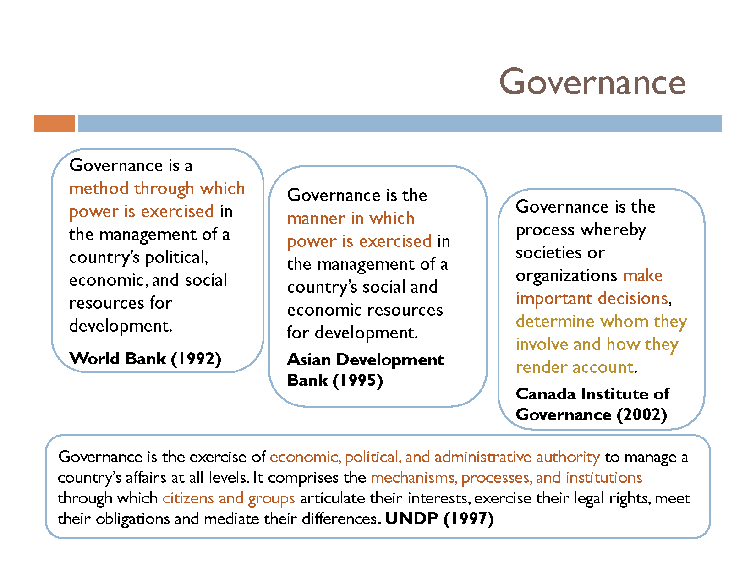

Slide 4
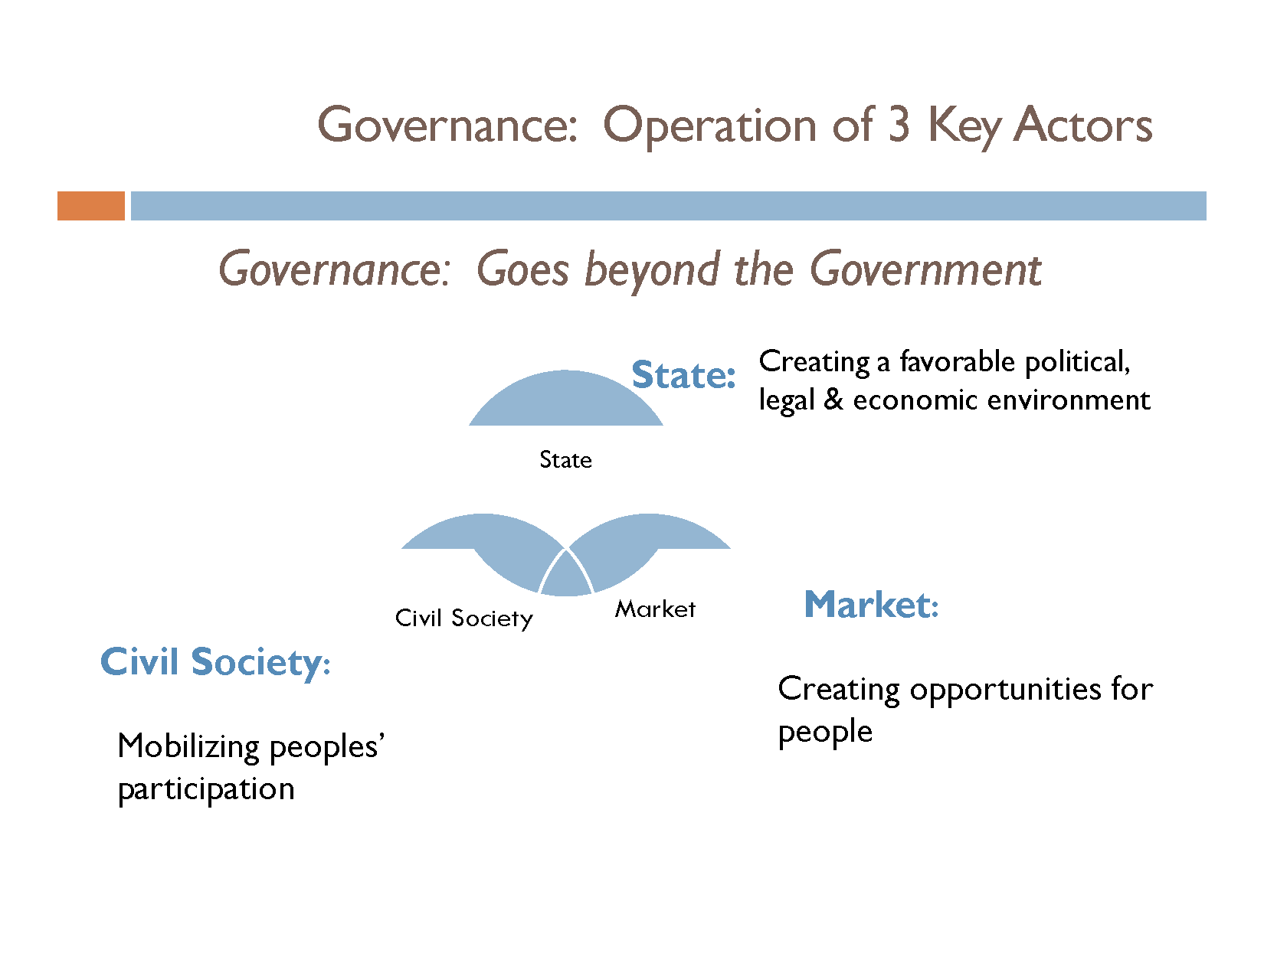

Slide 5
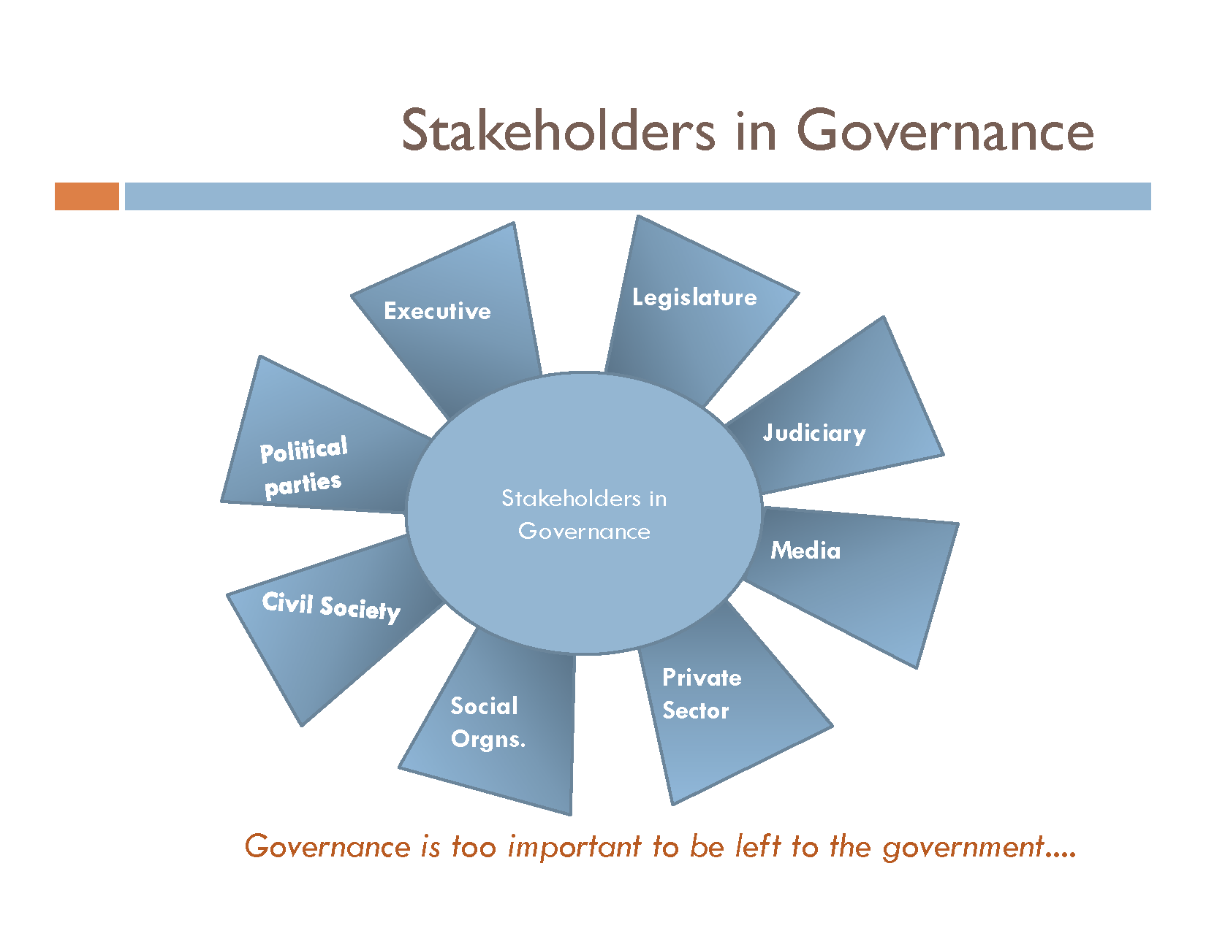

Slide 6
Good Governance
“ Good Governance is about the processes for making and implementing decisions.
Its not about making correct decisions, but about the best possible process for making those decision”

Slide 7
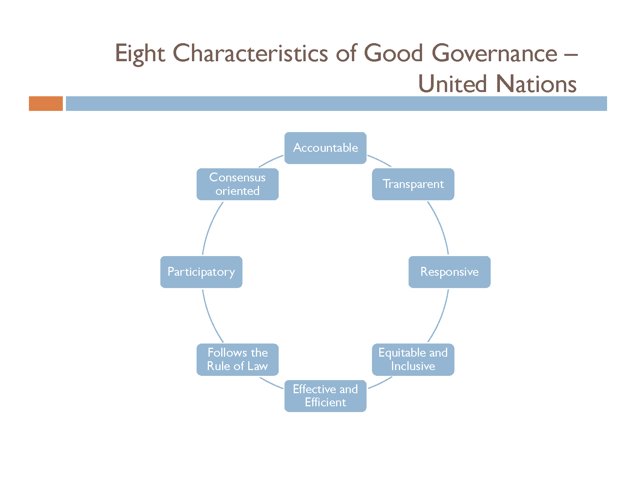

Slide 8
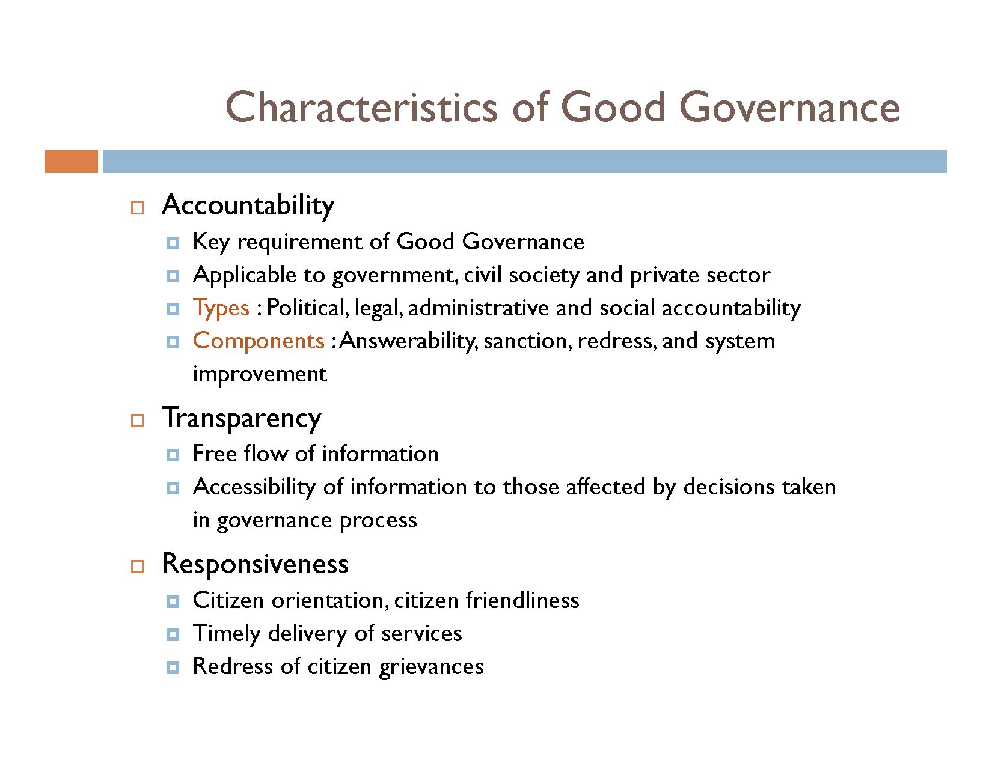

Slide 9
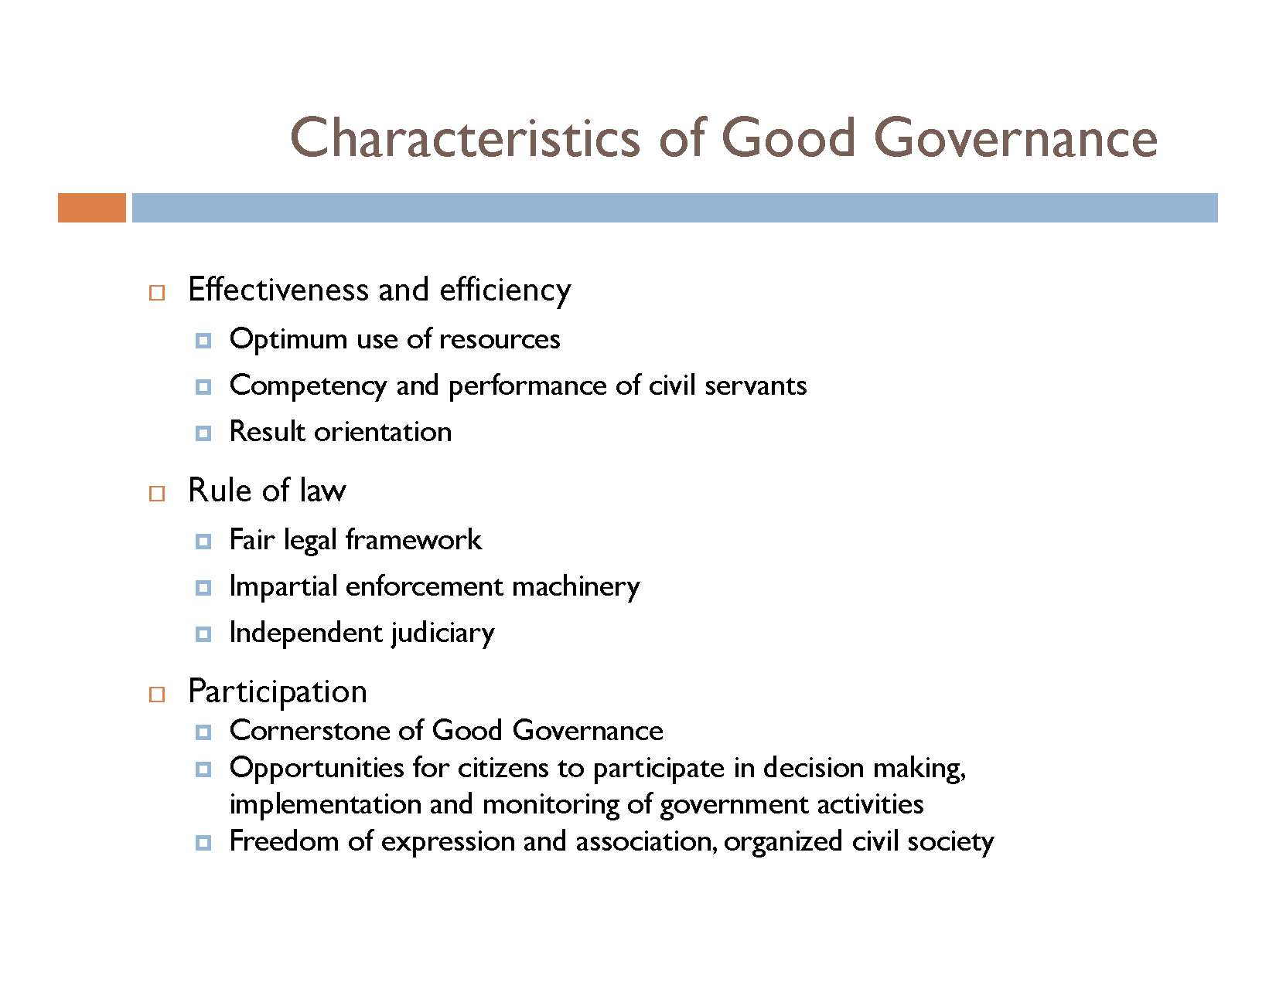

Slide 10
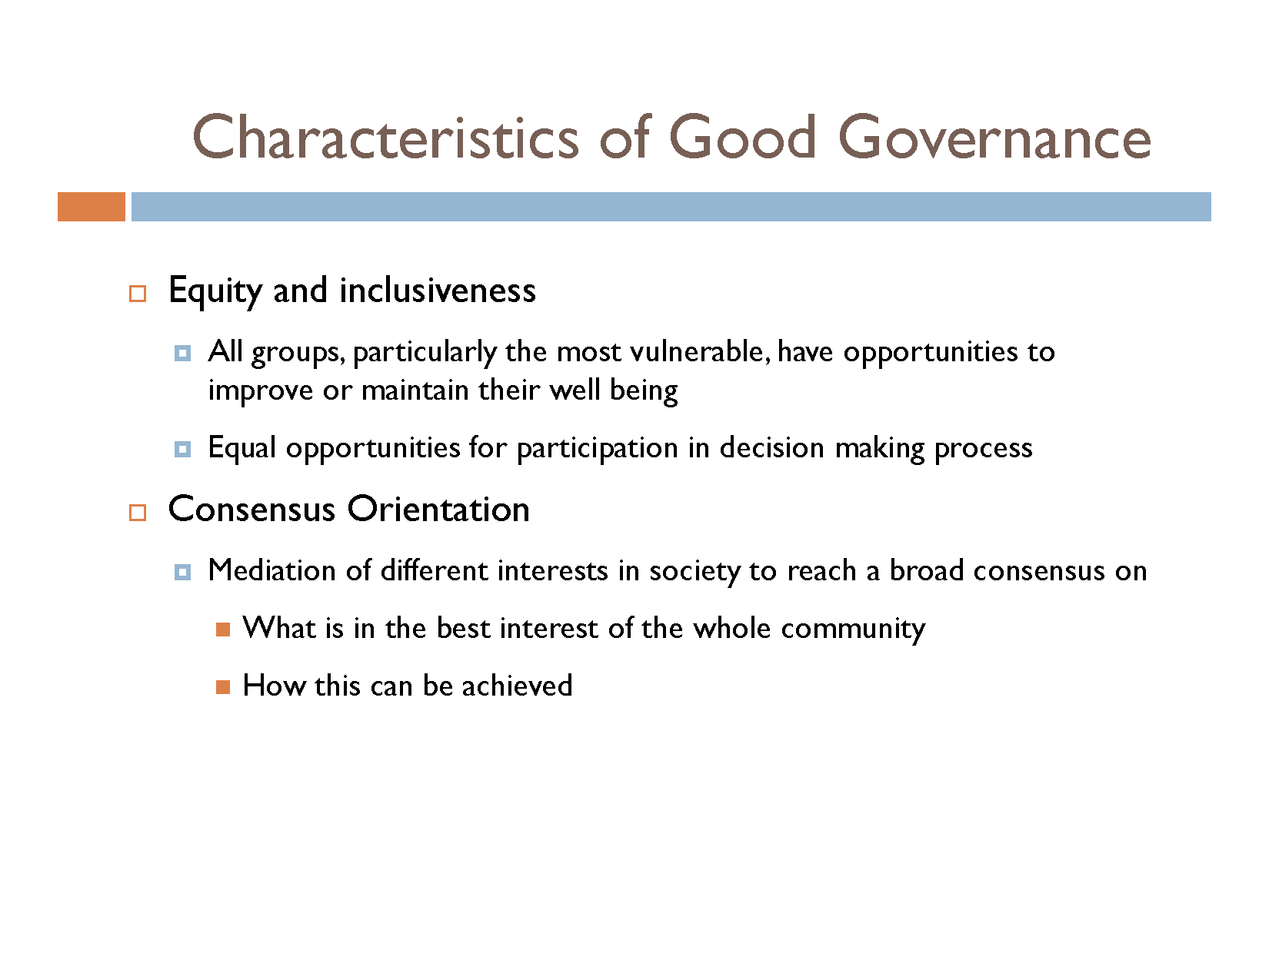

Slide 11
Essentials Of Good Governance
Equal Participation
Promotion Of National Cohesion
National Integration
Institution Supremacy
Independent Judiciary
Constitutional Supremacy
Rule Of Law
Political Stability
Free Media
Equal Educational Opportunities

Slide 12
Essentials Of Good Governance
Socio-economic Development
Equal Distribution Of Resources
Welfare State With Provision Of Social Securities
Strong Writ Of The Government On All Fronts

Slide 13
State Of Governance In Pakistan
Institutional Imbalance
Poor Relations Between Centre And Provinces
Political Instability
Inability To Provide Justice
Lack Of Control Over Law And Order Situation
Inefficient Economic Management
Expenditure Mismanagement And Debt Trap
Unfair System Of Taxation

Slide 14
State Of Governance In Pakistan
Lack Of Accountability
Corruption
Poverty And Inflation
Unemployment
Illiteracy
Overpopulation
Water, Energy And Food Crises
Sectarianism, Extremism and Terrorism

Slide 15
Recommendations
Balance Among All The Institutions
Good Relations Between Centre And Provinces
Equal Distribution Of National Resources
Cheap And Quick Justice
Economic Policies Be Revised
Cut Down In Extra-expenditure
Accountability
Establishment Of Anti-Corruption Courts
Free and Fair Media

Slide 16
Recommendations
New Industries be set up to provide Employment
Devolution of Power to grass root
Depoliticize State Institution
Population Growth be controlled
Poverty alleviation

Slide 17
Conclusion
The crisis, which is at the root of all other crises, is that of good governance. Problems like Poverty, Illiteracy, Unemployment, Corruption, Energy crisis, Terrorism, Water and Food shortage are weakening our country at its roots. In this gloomy scenario, good governance is the dire need of the hour. Though good governance has always been a dream for our country yet this dream can be transformed into reality. Sincere and dedicated leadership can make this dream come true.

